Slide 1
Disease Prediction Using ML Algorithm and Symptoms As a Precaution Basis
Created by:
Pranav Reveendran

Slide 2
Agenda
Abstract
Introduction
Literature Review
Working and Architecture
Implementation Details
Testing
Results
Conclusion

Slide 3
ABSTRACT
With big data growth in biomedical and healthcare communities, accurate analysis of medical data benefits early disease detection, patient care, and community services.
the analysis accuracy is reduced when the quality of medical data is incomplete.
Moreover, different regions exhibit unique characteristics of certain regional diseases, which may weaken the prediction of disease outbreaks. In this paper, we streamline machine learning algorithms for effective prediction of chronic disease outbreak in disease-frequent communities.

Slide 4
To overcome the difficulty of incomplete data, we use a latent factor model to reconstruct the missing data.
We experiment on a regional chronic disease of cerebral infarction.We propose a new decision tree ,Naive Bayes, Random forest algorithms using structured and unstructured data from hospital.
To the best of our knowledge, none of the existing work focused on both data types in the area of medical big data analytics. Compared with several typical prediction algorithms, the prediction accuracy of our proposed algorithm reaches 94.8% with a convergence speed, which is faster than that of the Other algorithms.

Slide 5
Introduction
Most of the disease become deadly because They can't be detected at an early stage.
If we can detect the disease as early as possible it is very easy to diagnosis.
Lives can be saved by this method.
With The advancement of Latest technologies and data collected, it has become so easy to detect disease at the earliest at very accurate way

Slide 6
Literature Survey
Karthiga, A.S., Mary, M.S. and Yogasins, M., 2017. Early Prediction of Heart Disease Using Decision Tree Algorithm. International Journal of Advanced Research in Basic Engineering Sciences and Technology, 3(3).
Cherian, V. and Bindu, M.S., 2017. Heart disease prediction using Naïve Bayes algorithm and Laplace smoothing technique. International Journal of Computer Science Trends and Technology (IJCST), 5(2).
Lebedev, A.V., Westman, E., Van Westen, G.J.P., Kramberger, M.G., Lundervold, A., Aarsland, D., Soininen, H., Kłoszewska, I., Mecocci, P., Tsolaki, M. and Vellas, B., 2014. Random Forest ensembles for detection and prediction of Alzheimer's disease with a good between-cohort robustness. NeuroImage: Clinical, 6, pp.115-125.

Slide 7
Algorithms Used
We Used Three of the famous classification algorithms:
Decision Tree
Random Forest
Naive Bayer’s

Slide 8
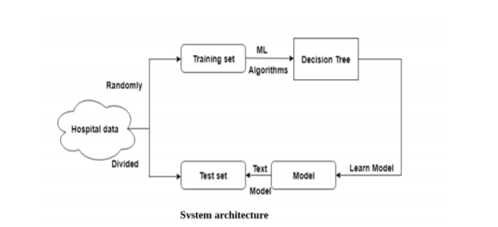
Architecture

Slide 9
Decision Tree
It is machine learning algorithm provides the machine with a set of decision-making rules which helps the them to learn something from the data.
A decision tree is a decision support tool that uses a tree-like model of decisions and their possible consequences, including chance event outcomes, resource costs, and utility.
It is one way to display an algorithm that only contains conditional control statements.
Simply put, a decision tree uses a tree-like data structure to make a model of the data using a bunch of if-else conditions at every node of the tree.
It can be used for both classification and regression analysis.

Slide 10
Random Forest
Random forests or random decision forests are an ensemble learning method for classification, regression.
It is made by constructing a multitude of decision trees at training time and outputting the class that is the mode of the classes (classification) or mean prediction (regression) of the individual trees.
Random decision forests correct for decision trees' habit of overfitting to their training set.
The classifier of Random Forest can handle missing values.
Random Forest classifier can be modeled for categorical values.
The general method of random decision forests was first proposed by Ho in 1995.

Slide 11
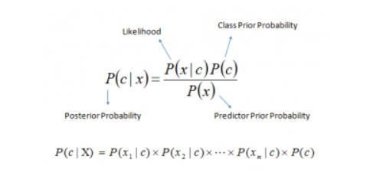
Naive Bayes
Its is one of the most popular and simple machine learning classification algorithms, the Naive Bayes algorithm.
It is based on the Bayes Theorem for calculating probabilities and conditional probabilities.
Bayes theorem provides a way of calculating posterior probability:
P(c|x) from P(c), P(x) and P(x|c). Look at the equation side
P(c|x) is the posterior probability of class (c, target)given predictor (x, attributes).
P(c) is the prior probability of class.
P(x|c) is the likelihood which is the probability of predictor given class.
P(x) is the prior probability of predictor.
:

Slide 12
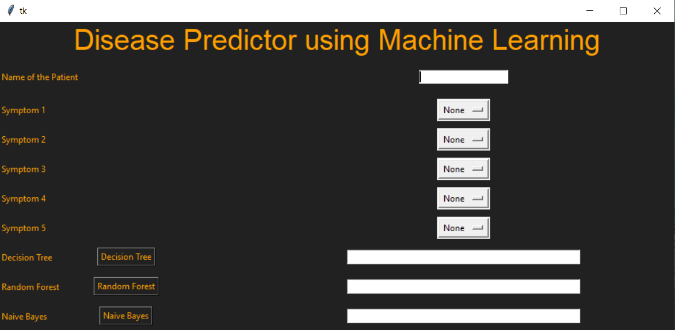
GUI

Slide 13
Libraries Used
Pandas
Numpy
Tkinter
SK Learn

Slide 14
TKInter
Tk is a free and open-source, cross-platform widget toolkit in Python
TKinter provides a library of basic elements of GUI widgets for building a GUI in many programming languages.
TK provides a number of widgets commonly needed to develop desktop applications:
Button
Menu
Canvas
Text

Slide 15
SK Learn
Scikit-learn (formerly scikits.learn and also known as sklearn) is a free software machine learning library for the Python programming language.
It features various classification, regression and clustering algorithms including support vector machines, random forests, gradient boosting, k-means and DBSCAN
It is designed to interoperate with the Python numerical and scientific libraries NumPy and SciPy.
Scikit-learn is largely written in Python, and uses numpy extensively for high-performance linear algebra and array operations.

Slide 16
Result and Conclusion
Results are predicted by three algorithms based on the symptoms.
They matches with the test data set and train the model
The Result are found to be at the accuracy of 89%
Since Three Results are compared and majority is taken, if two of the model matches, it accurately predicts the disease

Slide 17
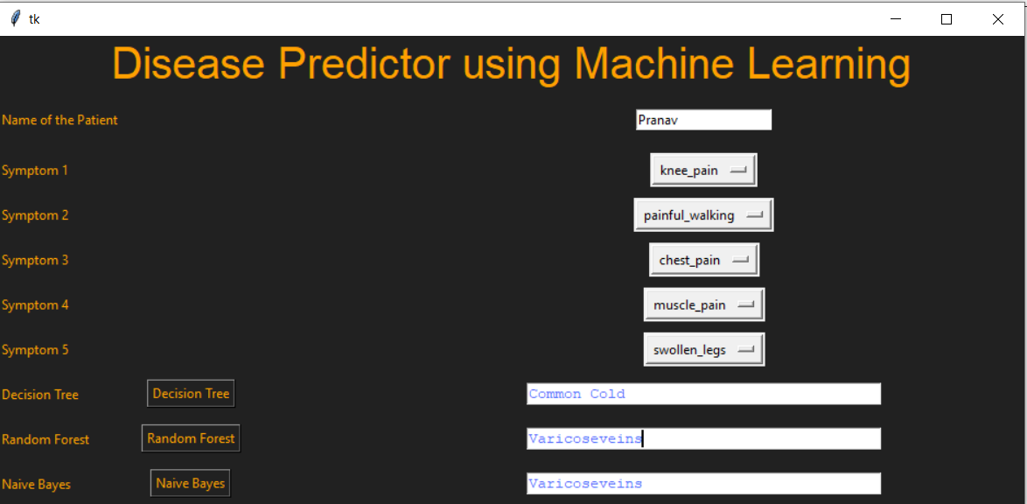
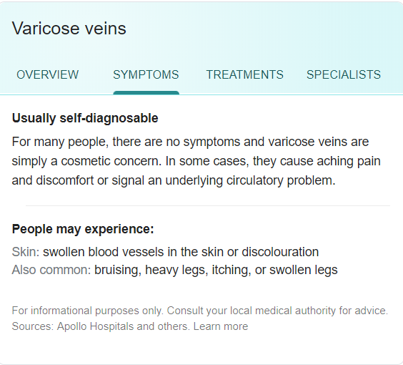
Example

Slide 18
Thank You

